Slide 1
Information Retrieval
Lecture 6: Evaluation
Based on: “Information Retrieval and Web Search” prepared
by Pandu Nayak and Prabhakar Raghavan

Slide 2
This lecture
Sec. 6.2
How do we know if our results are any good?
  Evaluating a search engine
    Benchmarks
    Precision and recall
Results summaries:
  Making our good results usable to a user

Slide 3
EVALUATING SEARCH ENGINES

Slide 4
Measures for a search engine
Sec. 8.6
How fast does it index
  Number of documents/hour
  (Average document size)
How fast does it search
  Latency as a function of index size
Expressiveness of query language
  Ability to express complex information needs
  Speed on complex queries
Uncluttered UI
Is it free?

Slide 5
Measures for a search engine
Sec. 8.6
All of the preceding criteria are measurable: we can quantify speed/size
  we can make expressiveness precise
The key measure: user happiness
  What is this?
  Speed of response/size of index are factors
  But blindingly fast, useless answers won’t make a user happy
Need a way of quantifying user happiness

Slide 6
Measuring user happiness
Sec. 8.6.2
Issue: who is the user we are trying to make happy?
  Depends on the setting
Web engine:
  User finds what s/he wants and returns to the engine
    Can measure rate of return users
  User completes task – search as a means, not end
  See Russell http://dmrussell.googlepages.com/JCDL-talk-June-2007-short.pdf
eCommerce site: user finds what s/he wants and buys
  Is it the end-user, or the eCommerce site, whose happiness we measure?
  Measure time to purchase, or fraction of searchers who become buyers?

Slide 7
Happiness: elusive to measure
Sec. 8.1
Most common proxy: relevance of search results
But how do you measure relevance?
We will detail a methodology here, then examine its issues
Relevance measurement requires 3 elements:
  A benchmark document collection
  A benchmark suite of queries
  A usually binary assessment of either Relevant or Nonrelevant for each query and each document
    Some work on more-than-binary, but not the standard

Slide 8
Evaluating an IR system
Sec. 8.1
Note: the information need is translated into a query
Relevance is assessed relative to the information need not the query
E.g., Information need: I'm looking for information on whether drinking red wine is more effective at reducing your risk of heart attacks than white wine.
Query: wine red white heart attack effective
Evaluate whether the doc addresses the information need, not whether it has these words

Slide 9
Standard relevance benchmarks
Sec. 8.2
TREC - National Institute of Standards and Technology (NIST) has run a large IR test bed for many years
Reuters and other benchmark doc collections used
“Retrieval tasks” specified
  sometimes as queries
Human experts mark, for each query and for each doc, Relevant or Nonrelevant
  or at least for subset of docs that some system returned for that query

Slide 10
Unranked retrieval evaluation:
Precision and Recall
Sec. 8.3
Precision: fraction of retrieved docs that are relevant = P(relevant|retrieved)
Recall: fraction of relevant docs that are retrieved
= P(retrieved|relevant)
Precision P = tp/(tp + fp)
Recall R = tp/(tp + fn)
 | Relevant | Nonrelevant
Retrieved | tp | fp
Not Retrieved | fn | tn

Slide 11
Should we instead use the accuracy measure for evaluation?
Sec. 8.3
Given a query, an engine classifies each doc as “Relevant” or “Nonrelevant”
The accuracy of an engine: the fraction of these classifications that are correct
  (tp + tn) / ( tp + fp + fn + tn)
Accuracy is a commonly used evaluation measure in machine learning classification work
Why is this not a very useful evaluation measure in IR?

Slide 12
Why not just use accuracy?
Sec. 8.3
How to build a 99.9999% accurate search engine on a low budget….
People doing information retrieval want to find something and have a certain tolerance for junk.
Snoogle.com
Search for:
0 matching results found.

Slide 13
Precision/Recall
Sec. 8.3
You can get high recall (but low precision) by retrieving all docs for all queries!
Recall is a non-decreasing function of the number of docs retrieved
In a good system, precision decreases as either the number of docs retrieved or recall increases
  This is not a theorem, but a result with strong empirical confirmation

Slide 14
Difficulties in using precision/recall
Sec. 8.3
Should average over large document collection/query ensembles
Need human relevance assessments
  People aren’t reliable assessors
Assessments have to be binary
  Nuanced assessments?
Heavily skewed by collection/authorship
  Results may not translate from one domain to another

Slide 15
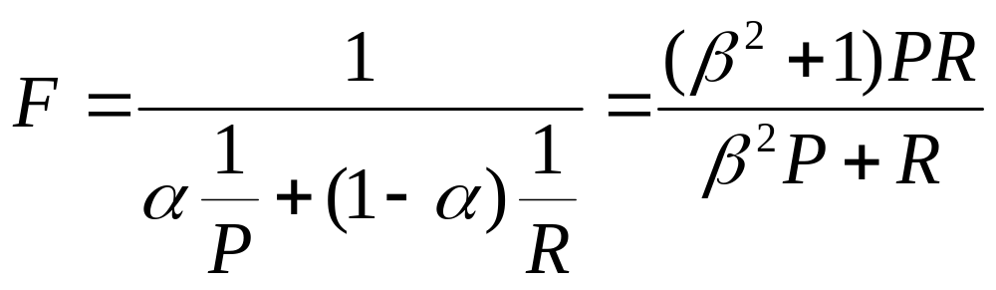
A combined measure: F
Sec. 8.3
Combined measure that assesses precision/recall tradeoff is F measure (weighted harmonic mean):
People usually use balanced F₁ measure
  i.e., with β = 1 or α = ½ β = (1- α)/ α
Harmonic mean is a conservative average
  See CJ van Rijsbergen, Information Retrieval

Slide 16
Compare: arithmetic and harmonic means
Return ALL documents => Recall = 100%
Arithmetic mean >= 50%
Harmonic mean ?
Suppose: 1 of 10000 docs is relevant, return ALL
Arithmetic mean = (100+ 0.01)/2 > 50%
Harmonic mean = 2*100*0.01/(100.01) < 0.02%
Harmonic mean <= arithmetic (and geometric) means
Harmonic mean is always closer to the minimum and not average!

Slide 17
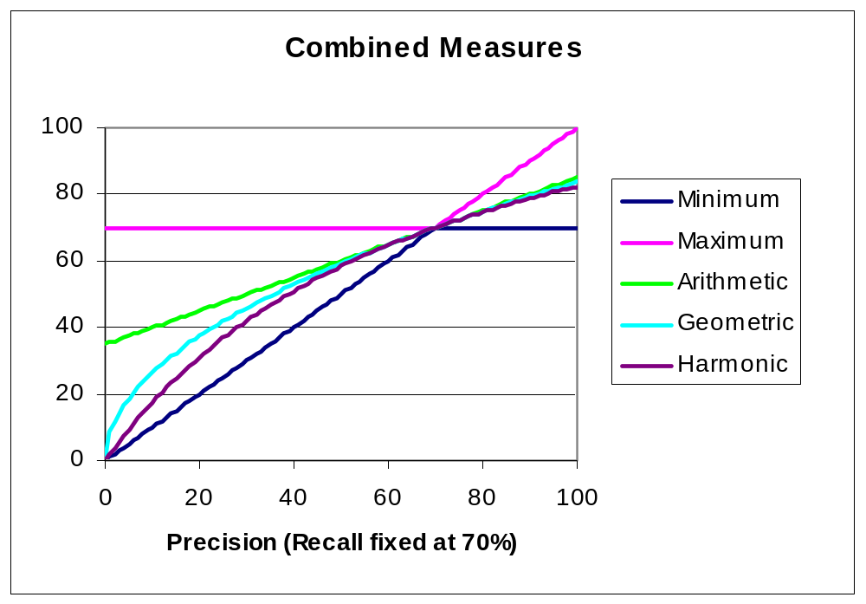
F₁ and other averages
Sec. 8.3
Notes:
The geometric mean is defined as the nth root (where n is the count of numbers) of the product of the numbers.
For instance, the geometric mean of two numbers, say 2 and 8, is just the square root of their product; that is ²√2 × 8 = 4. As another example, the geometric mean of the three numbers 4, 1, and 1/32 is the cube root of their product (1/8), which is 1/2; that is³√4 × 1 × 1/32 = ½ .

Slide 18
Evaluating ranked results
Sec. 8.4
Evaluation of ranked results:
  The system can return any number of results
  By taking various numbers of the top returned documents (levels of recall), the evaluator can produce a precision-recall curve

Slide 19
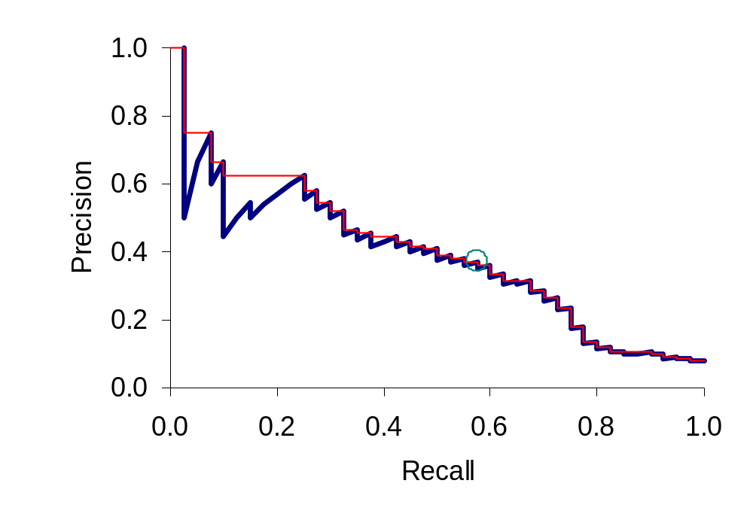
A precision-recall curve
Sec. 8.4

Slide 20
Averaging over queries
Sec. 8.4
A precision-recall graph for one query isn’t a very sensible thing to look at
You need to average performance over a whole bunch of queries.
But there’s a technical issue:
  Precision-recall calculations place some points on the graph
  How do you determine a value (interpolate) between the points?

Slide 21
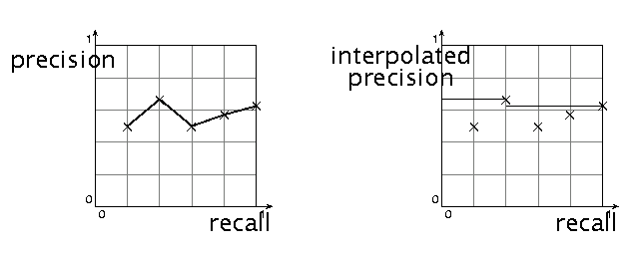
Interpolated precision
Sec. 8.4
Idea: If locally precision increases with increasing recall, then you should get to count that…
So you take the max of precisions to right of value

Slide 22
Evaluation
Sec. 8.4
Graphs are good, but people want summary measures!
  Precision at fixed retrieval level
    Precision-at-k: Precision of top k results
    Perhaps appropriate for most of web search: all people want are good matches on the first one or two results pages
    But: averages badly and has an arbitrary parameter of k
  11-point interpolated average precision
    The standard measure in the early TREC competitions: you take the precision at 11 levels of recall varying from 0 to 1 (by tenths), using interpolation (the value for 0 is always interpolated!), and average them
    Evaluates performance at all recall levels

Slide 23
11-point interpolated precision
Recall | Interp.
 | Precision
0.0 | 1.00
0.1 | 0.67
0.2 | 0.63
0.3 | 0.55
0.4 | 0.45
0.5 | 0.41
0.6 | 0.36
0.7 | 0.29
0.8 | 0.13
0.9 | 0.10
1.0 | 0.08

Slide 24
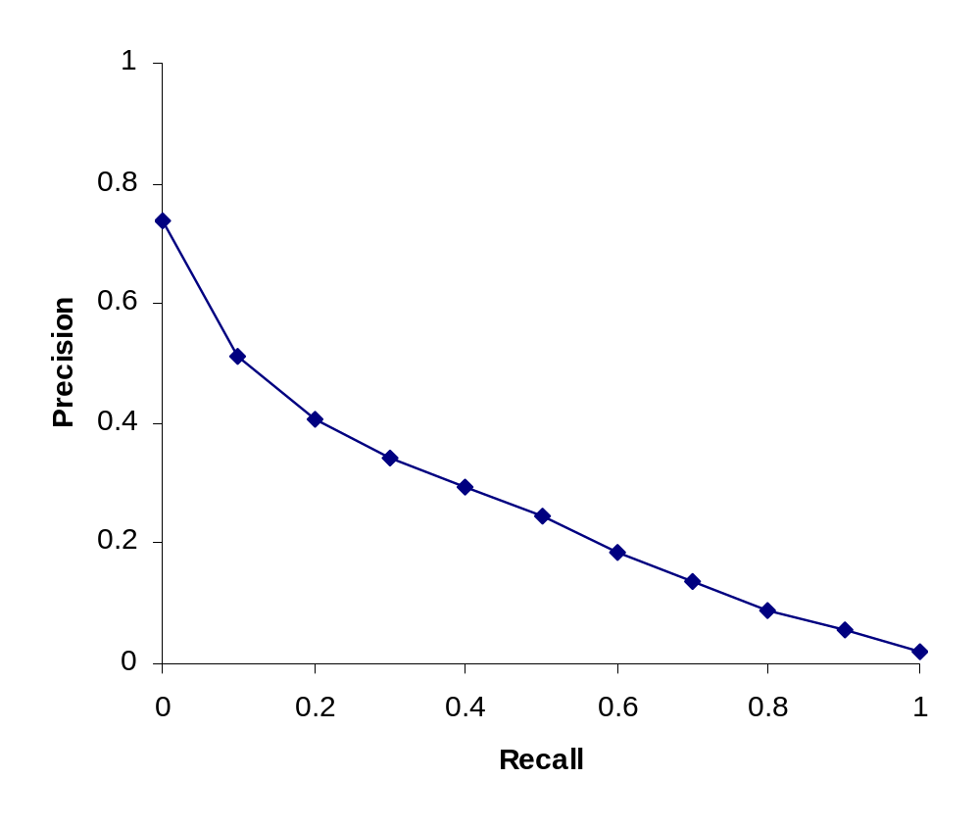
Typical (good) 11 point precisions
Sec. 8.4
SabIR/Cornell 8A1 11pt precision from TREC 8 (1999)

Slide 25

Yet more evaluation measures…
Sec. 8.4
Mean average precision (MAP)
  Average of the precision value obtained for the top k documents, each time a relevant doc is retrieved
  Avoids interpolation, use of fixed recall levels
  MAP for query collection is arithmetic ave.
    Macro-averaging: each query counts equally

Slide 26
Yet more evaluation measures…
R-precision
  If we have a known (though perhaps incomplete) set of relevant documents of size Rel, then calculate precision of the top Rel docs returned
  Perfect system could score 1.0 (no false positive until the last relevant doc).

Slide 27
ROC curve (Receiver Operating Characteristics)
plots the true positive rate or sensitivity (recall) against the false positive rate
False positive rate is given by FP/(FP + TN), TN – unranked sets (how much of negative examples were ranked as “positive” by a system?)
  equals 1 – specificity
specificity , given by TN/(FP + TN) (how much of negative examples were not ranked by a system?)

Slide 28
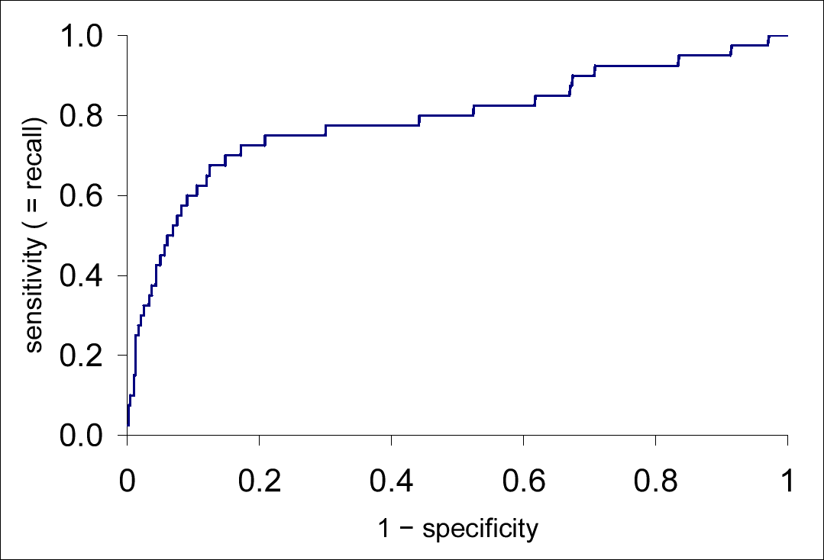
AUC - Area under curve
Good ROC = large AUC

Slide 29

CG (Cumulative Gain)
The sum of the graded relevance values of all results in the result list.
  Does not include the position of a result in the result set.
The CG at a particular rank position p is defined as:
is the graded relevance of the result at position i.
The value of CG is unaffected by changes in the ordering of search results.
DCG is used in place of CG for a more accurate measure.

Slide 30

DCG (Discounted Cumulative Gain)
The intuition of DCG -- highly relevant documents appearing lower in a search result list should be penalized
  as the graded relevance value is reduced logarithmically proportional to the position of the result.
The discounted CG accumulated at a particular rank position p is defined as:
  using a logarithmic reduction factor produces a smooth reduction.

Slide 31

nDCG (normalized DCG)
Search result lists vary in length depending on the query.
Comparing a search engine's performance from one query to the next cannot be consistently achieved.
The cumulative gain at each position for a chosen value of p should be normalized across queries.
  by sorting documents of a result list by relevance, producing the maximum possible DCG (aka Ideal DCG (IDCG)) till that position.
The normalized discounted cumulative gain, or nDCG, is computed as:
Notes:
reli has different domain (interval) for different queries

Slide 32
nDCG across queries
The nDCG values for all queries can be averaged to obtain a measure of the average performance of a ranking algorithm.
  a perfect ranking algorithm will produce an nDCG of 1.0.
All nDCG calculations are then relative values on the interval 0.0 to 1.0 and so are cross-query comparable.

Slide 33
Example
Presented with a list of documents in response to a search query, an experiment participant is asked to judge the relevance of each document to the query.
Each document is to be judged on a scale of 0-3 with 0 meaning irrelevant, 3 meaning completely relevant, and 1 and 2 meaning "somewhere in between".
For the documents ordered by the ranking algorithm as
the user provides the following relevance scores:
That is: document 1 has a relevance of 3, document 2 has a relevance of 2, etc.

Slide 34

binary relevance
The Cumulative Gain of this search result listing is:
Changing the order of any two documents does not affect the CG measure. If D3 and D4 are switched, the CG remains the same, 11

Slide 35

consider order
DCG is used to emphasize highly relevant documents appearing early in the result list. Using the logarithmic scale for reduction, the DCG for each result in order is:
So the DCG₆ of this ranking is:
1 | 3 | 0 | N/A
2 | 2 | 1 | 2
3 | 3 | 1.585 | 1.899
4 | 0 | 2.0 | 0
5 | 1 | 2.322 | 0.431
6 | 2 | 2.584 | 0.772

Slide 36
consider order
Now a switch of D3 and D4 results in a reduced DCG
  a less relevant document is placed higher in the ranking;
  a more relevant document is discounted more
The performance of this query to another is incomparable in this form since the other query may have more results, resulting in a larger overall DCG.

Slide 37

normalizing
To normalize DCG values, an ideal ordering for the given query is needed.
  For this example, it is (by decreasing sort of the relevance judgments) as follows:
The DCG of this ideal ordering, or IDCG, is then:
And so the nDCG for this query is given as:

Slide 38
CREATING TEST COLLECTIONS
FOR IR EVALUATION

Slide 39
From document collections to test collections
Sec. 8.5
Still need
  Test queries
  Relevance assessments
Test queries
  Must be relevant to docs available
  Best designed by domain experts
  Random query terms generally not a good idea
Relevance assessments
  Human judges, time-consuming
  Are human panels perfect?

Slide 40
Kappa measure for inter-judge (dis)agreement
Sec. 8.5
Kappa measure
  Agreement measure among judges
  Designed for categorical judgments
  Corrects for chance agreement
Kappa = [ P(A) – P(E) ] / [ 1 – P(E) ]
P(A) – proportion of time judges agree
P(E) – what agreement would be by chance
Kappa = 0 for chance agreement, 1 for total agreement.

Slide 41
Kappa Measure: Example
Sec. 8.5
P(A)? P(E)?
Number of docs | Judge 1 | Judge 2
300 | Relevant | Relevant
70 | Nonrelevant | Nonrelevant
20 | Relevant | Nonrelevant
10 | Nonrelevant | Relevant

Slide 42
Kappa Example
Sec. 8.5
P(A) = 370/400 = 0.925
P(nonrelevant) = (10+20+70+70)/800 = 0.2125
P(relevant) = (10+20+300+300)/800 = 0.7878
P(E) = 0.2125^2 + 0.7878^2 = 0.665
Kappa = (0.925 – 0.665)/(1-0.665) = 0.776
Kappa > 0.8 = good agreement
Depends on purpose of study
For >2 judges: average pairwise kappas

Slide 43
Evaluation at large search engines
Sec. 8.6.3
Search engines have test collections of queries and hand-ranked results
Recall is difficult to measure on the web
Search engines often use precision at top k, e.g., k = 10
. . . or measures that reward you more for getting rank 1 right than for getting rank 10 right.
  NDCG (Normalized Cumulative Discounted Gain)
Search engines also use non-relevance-based measures.
  Clickthrough on first result
    Not very reliable if you look at a single clickthrough … but pretty reliable in the aggregate.
  Studies of user behavior in the lab
  A/B testing
Notes:
Not very reliable if you look at a single clickthrough (you may
realize after clicking that the summary was misleading and the
document is nonrelevant) . . .

Slide 44
A/B testing
Sec. 8.6.3
Purpose: Test a single innovation
Prerequisite: You have a large search engine up and running.
Have most users use old system
Divert a small proportion of traffic (e.g., 1%) to the new system that includes the innovation
Evaluate with an “automatic” measure like clickthrough on first result
We can see if the innovation does improve user happiness.
Probably the evaluation methodology that large search engines trust most

